Slide 1
Operating system
Computer system architecture

Slide 2
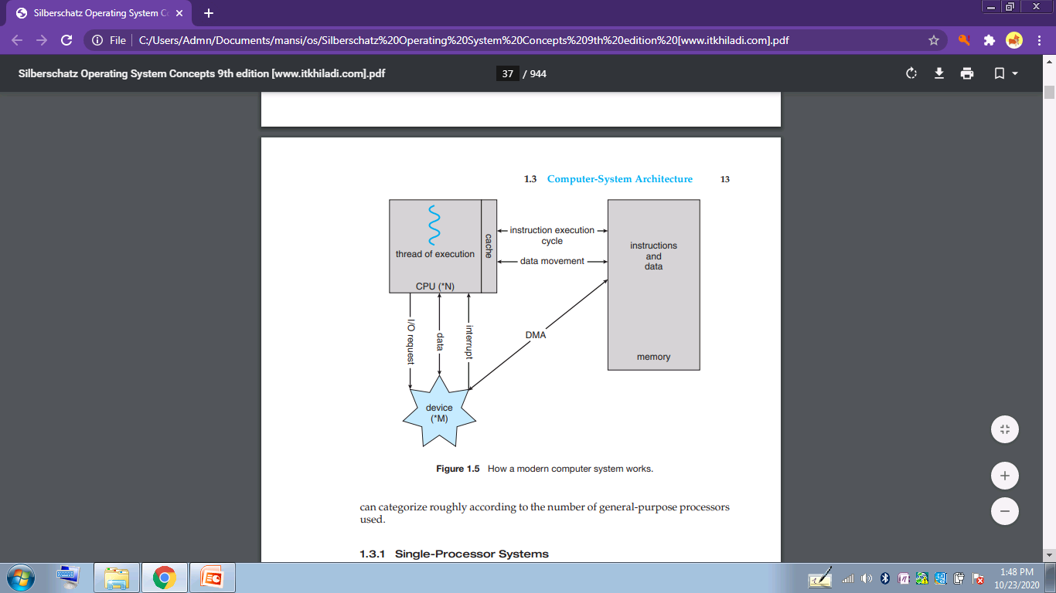

Slide 3
Single –processor system
Most computer systems used a single processor
On a single processor system, there is one main CPU capable of executing a general-purpose instruction set, including instructions from user processes.
So only one process can be executed at a time and then the process is selected from the ready queue.

Slide 4
Multi –processor system
Multiprocessor systems (also known as parallel systems or multicore systems) Such systems have two or more processors in close communication, sharing the computer bus and sometimes the clock, memory, and peripheral devices.

Slide 5
Multiprocessor systems have three main advantages:
Increased throughput-
Throughput is equal to Number of completed processes per time unit
Economy of scale- Multiprocessor systems can cost less than equivalent multiple single-processor systems, because they can share peripherals, mass storage, and power supplies.
Increased reliability-chance of less failure .

Slide 6
The ability to continue providing service proportional to the level of surviving hardware is called graceful degradation
Some systems go beyond graceful degradation and are called fault tolerant, because they can suffer a failure of any single component and still continue operation.

Slide 7
The multiple-processor systems in use today are of two types.
asymmetric multiprocessing- in which each processor is assigned a specific task. A boss processor controls the system; the other processors either look to the boss for instruction or have predefined tasks. This scheme defines a boss–worker relationship. The boss processor schedules and allocates work to the worker processors.

Slide 8
The most common systems use symmetric multiprocessing (SMP), in which each processor performs all tasks within the operating system. SMP means that all processors are peers; no boss–worker relationship exists between processors. each processor has its own set of registers, as well as a private—or local —cache. However, all processors share physical memory.
Eg: AIX, a commercial version of UNIX designed by IBM, Windows, Mac OS X, and Linux

Slide 9
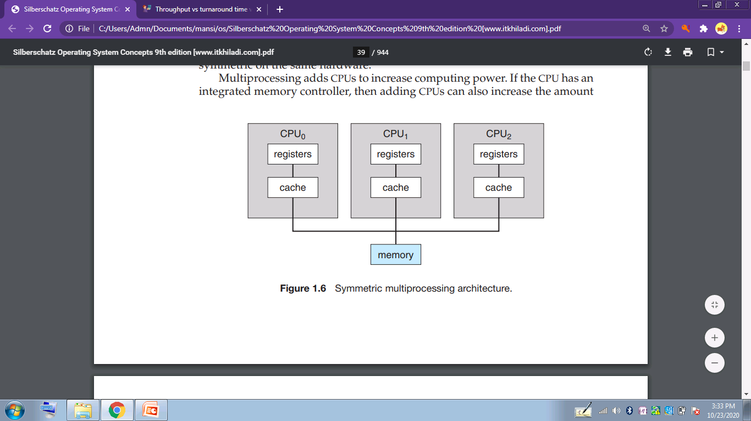

Slide 10
multiprocessing can cause a system to change its memory access model from uniform memory access (UMA) to non-uniform memory access (NUMA).
UMA is defined as the situation in which access to any RAM from any CPU takes the same amount of time.
NUMA, some parts of memory may take longer to access than other parts, creating a performance penalty.

Slide 11
Multicore systems
Some multiprocessor systems are termed multicore. They can be more efficient than multiple chips with single cores because on-chip communication is faster than between-chip communication. In addition, one chip with multiple cores uses significantly less power than multiple single-core chips
while multicore systems are multiprocessor systems, not all multiprocessor systems are multicore

Slide 12
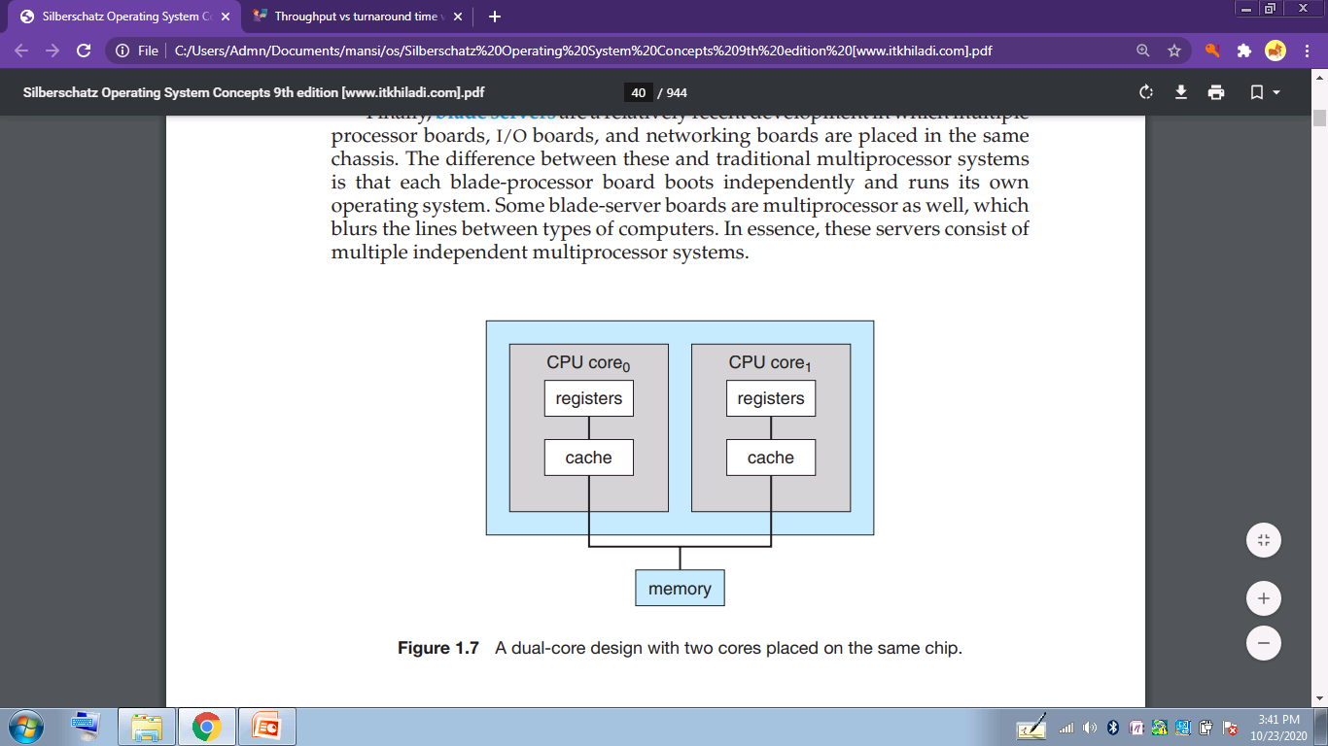

Slide 13
blade servers
In this multiple processor boards, I/O boards, and networking boards are placed in the same chassis.
Some blade-server boards are multiprocessor as well, which blurs the lines between types of computers.
these servers consist of multiple independent multiprocessor systems.
The difference between these and traditional multiprocessor systems is that each blade-processor board boots independently and runs its own operating system.

